Slide 1

Adding search to a website using Azure
Chicago Code Camp
April 30, 2016

Slide 2

SPONSORS

Slide 3

Paul Schaeflein
SharePoint Solution Architect / Developer
Speaker / Trainer / Mentor
Microsoft MVP – Office Server and Services

Slide 4
Agenda
What is Azure
What is Azure Search
Azure Search configuration
Adding data
Searching index
Question and Answer

Slide 5
What is Azure?

Slide 6
What is Azure?
<meta name="description" content="Microsoft Azure is an open, flexible, enterprise-grade cloud computing platform. Move faster, do more, and save money with IaaS + PaaS. Try for FREE.">
Infrastructure as a Service
Platform as a Service
More…

Slide 7
What is Azure Search?

Slide 8
What is Azure Search?
“Fully managed Search as a Service”
High availability
Data integration: Azure SQL Database, Azure DocumentDB, Azure Blob storage
Document cracking (currently in preview): read and index major file formats
Search traffic analytics
Scoring profiles
Sorting / Paging and throttling
Search explorer

Slide 9
What is Azure Search?
Powerful Search Experience
Simple query syntax
56 different languages.
Lucene analyzers and Microsoft analyzers
Search suggestions
Hit highlighting
Faceted navigation
Geo-spatial support

Slide 10
Azure Search Configuration

Slide 11
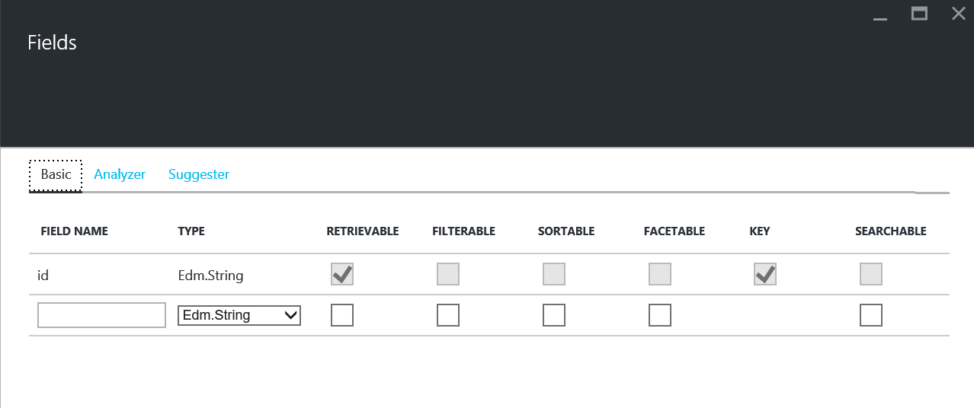
Azure Search Configuration

Slide 12
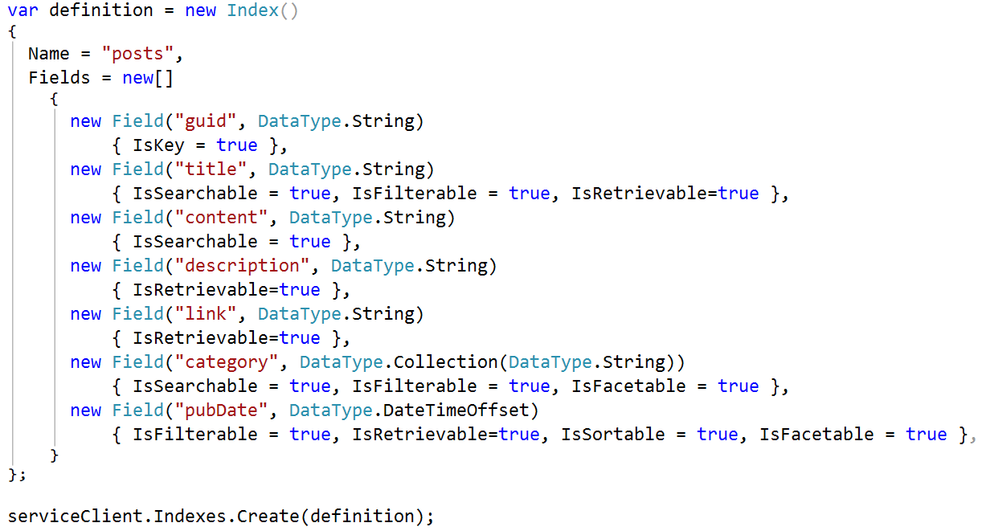
Azure Search Configuration

Slide 13
Adding Data

Slide 14
Adding Data
Push Data
REST
.NET
Batches up to 1,000 items / 16mb
Pull Data
“Indexer” run by the service
Supported data sources
Blob storage (preview)
Document DB
Azure SQL
SQL Server on Azure VM

Slide 15
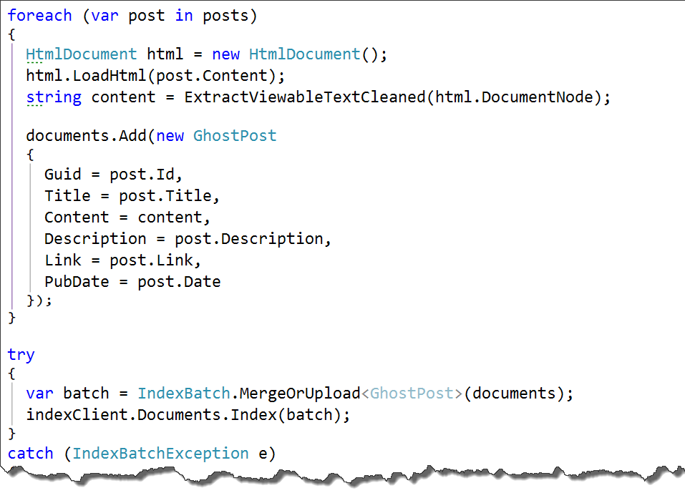
Adding data (.NET SDK)

Slide 16
Searching the Index

Slide 17
Search the Index (REST API)
if (searchTerm != null) {
$.ajax({
dataType: 'json',
url: 'https://[name].search.windows.net/indexes/posts/docs
?api-version=2015-02-28
&highlight=content
&highlightPreTag=%3Cspan style="background:yellow;"%3E
&highlightPostTag=%3c/span%3E
&search=' + searchTerm,
beforeSend: function (xhr) { xhr.setRequestHeader('api-key', '[api-key]') },
type: 'GET'
}).success(renderSearchResults); }

Slide 18
Questions?
https://github.com/pschaeflein/ccc-azure-search http://www.schaeflein.net paul@schaeflein.net @paulschaeflein

